Slide 1
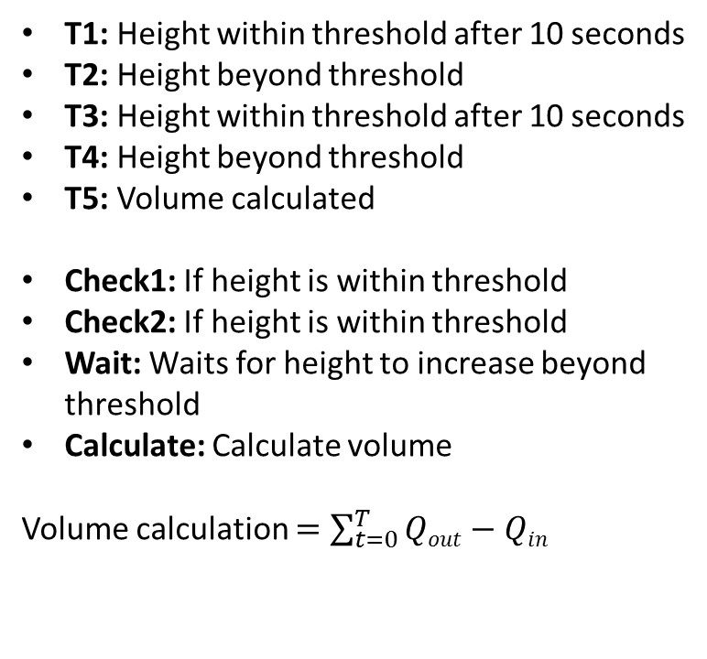
Check 1
T1: Height within threshold after 10 seconds
T2: Height beyond threshold
T3: Height within threshold after 10 seconds
T4: Height beyond threshold
T5: Volume calculated
Check1: If height is within threshold
Check2: If height is within threshold
Wait: Waits for height to increase beyond threshold
Calculate: Calculate volume
Volume calculation $=\sum_{t=0}^{T}{Qout−Qin}$
T1
T2
Check 2
T3
T5
Wait for Object Drop
T4
Calculate Volume

